Slide 1
基本图形的绘制

Slide 2
basic structure of OpenGL programs
main():
    定义回调函数
    创建窗口
    enters event loop
init(): sets the state variables
    Viewing
    Attributes
callbacks
    Display function
    Input and window functions

Slide 3
includes gl.h
#include <GL/glut.h>
int main(int argc, char** argv)
{
glutInit(&argc,argv);
glutInitDisplayMode(GLUT_SINGLE|GLUT_RGB);
glutInitWindowSize(500,500);
glutInitWindowPosition(0,0);
glutCreateWindow("simple");
glutDisplayFunc(mydisplay);
init();
glutMainLoop();
}
define window properties
display callback
set OpenGL state
enter event loop

Slide 4
glut
glutInit allows application to get command line arguments and initializes system
gluInitDisplayMode requests properties for the window (the rendering context)
  RGB color
  Single buffering
  Properties logically ORed together
glutWindowSize in pixels
glutWindowPosition from top-left corner of display
glutCreateWindow create window with title “simple”
glutDisplayFunc display callback
glutMainLoop enter infinite event loop

Slide 5
init.c
void init()
{
glClearColor (0.0, 0.0, 0.0, 1.0);
glColor3f(1.0, 1.0, 1.0);
glMatrixMode (GL_PROJECTION);
glLoadIdentity ();
glOrtho(-1.0, 1.0, -1.0, 1.0, -1.0, 1.0);
}
black clear color
opaque window
fill/draw with white
viewing volume

Slide 6
基本图形
All geometric primitives are specified by vertices
GL_LINES
GL_POLYGON
GL_POINTS
GL_LINE_STRIP
GL_LINE_LOOP
GL_TRIANGLES
GL_QUADS
GL_QUAD_STRIP
GL_TRIANGLE_STRIP
GL_TRIANGLE_FAN

Slide 7
定义基本图形
Primitives are specified using
      glBegin( primType );
      glEnd();
  primType determines how vertices are combined

Slide 8
Simple Example
void drawRhombus( GLfloat color[] )
{
glBegin( GL_QUADS );
    glColor3fv( color );
    glVertex2f( 0.0, 0.0 );
    glVertex2f( 1.0, 0.0 );
    glVertex2f( 1.0, 1.0);
    glVertex2f( 0.5, 1.0 );
glEnd();
}
See Demo.

Slide 9
OpenGL Command Formats
glVertex3fv( v )
Number of
components
Data Type
Vector
b - byte
ub - unsigned byte
s - short
us - unsigned short
i - int
ui - unsigned int
f - float
d - double
omit “v” for
scalar form
glVertex2f( x, y )
2 - (x,y)
3 - (x,y,z)
4 - (x,y,z,w)

Slide 10
OpenGL Color Models
RGBA or Color Index
Red
Green
Blue
0
1
1
Display
2
2
4
8
3

16


24
123
219
74
25
26


Slide 11
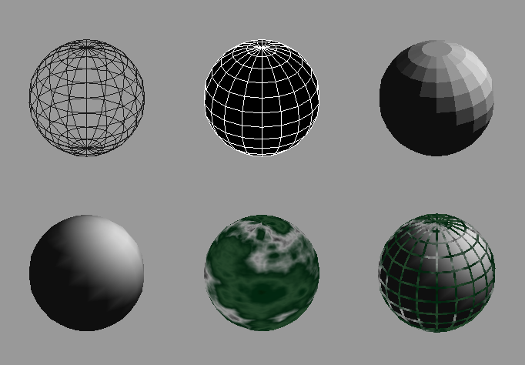
Controlling Rendering Appearance
From Wireframe to Texture Mapped

Slide 12
OpenGL’s State Machine
All rendering attributes are encapsulated in the OpenGL State
  rendering styles
  shading
  lighting
  texture mapping

Slide 13
Manipulating OpenGL State
Appearance is controlled by current state
  for each ( primitive to render ) {
    update OpenGL state
    render primitive
  }
Manipulating vertex attributes is most
common way to manipulate state
    glColor*() / glIndex*()
    glNormal*()
    glTexCoord*()

Slide 14
Controlling current state
Setting State
    glPointSize( size );
    glLineStipple( repeat, pattern );
    glShadeModel( GL_SMOOTH );
Enabling Features
    glEnable( GL_LIGHTING );
    glDisable( GL_TEXTURE_2D );

Slide 15
实验内容
绘制基本图形：线段，多边形等。
修改图形的颜色。
参考资料：
  在线OpenGL手册 OpenGL Online Manual
  https://www2.cs.sfu.ca/~haoz/teaching/openglman.html
  https://www2.cs.sfu.ca/~haoz/teaching/htmlman/begin.html
  https://www2.cs.sfu.ca/~haoz/teaching/openglman.html

